Slide 1
Introduction to linux
University of Maryland Programming Club

Slide 2
History
In 1969 developers at Bell Labs started working on Unix
Written in C instead of assembly
Ability to recycle code
Called UNIX

Slide 3
History – Torvalds
Linux Torvalds, student studying computer science at the University of Helsinki
Thought it would be cool to have a free academic/home version of Linux
Got help and coded it up
Original post: http://www.linux.org/people/linus_post.html

Slide 4
History – Richard Stallman/GNU
1983 Richard Stallman started GNU project
Wanted to create free Unix-like OS
Wrote GNU General Public License (GPL)
Today we use Linux Kernel with GNU tools.
Examples of GNU tools are gcc, gdb, emacs, bash, etc.

Slide 5
Properties of Linux
Open Source – Free as in free beer and speech
Portable
Scalable
Secure
Growing in popularity for the general populace!
Especially programmers!

Slide 6
It’s not that difficult
Today Linux is easy to switch to
GUI available, with terminal always there
Excellent community to ask for help
Fast and efficient. Will run well on old computers
Honestly once you get into it, it will grow on you

Slide 7
Distros
Ubuntu – Easy :)
Fedora
Debian
openSUSE
Slackware
Linux from Scratch

Slide 8
Cool Stuff
Open Office
The Gimp
Compiz Fusion
Docky
Gnome Do
Synaptic Package Manager (for debian based)

Slide 9
Editors
Learn an Editor and stick with it.
Lots of choices available:
Vi/Vim/Gvim – Vi is standard.
Emacs – The contender to Vim, and can do everything.
Gedit – “Normal” text editor. Lots of plugins.
Nano/Joe/Pico/etc. – Not for serious work please.

Slide 10
Vi/Vim/Gvim
Vim is a modal text editor. Hard to use at first.
Over 15-30 years old
Vi is default installed on almost every distro
Highly customizable through .vimrc
http://www.viemu.com/a-why-vi-vim.html
Answers many misconceptions
http://tottinge.blogsome.com/use-vim-like-a-pro/
Pretty good starting reference

Slide 11
Command Line
Not for day to day tasks
Fast and Efficient (tab completion, batch commands)
Great for working remotely
Powerful Scripting (bash scripts)
The command line != DOS

Slide 12
First rule of Linux
Don’t ever log in as root
Windows logs you in as root by default and well…
rm –rf *
Ubuntu gets around this problem by making you run in superuser mode when you need it only
sudo apt-get install vim

Slide 13
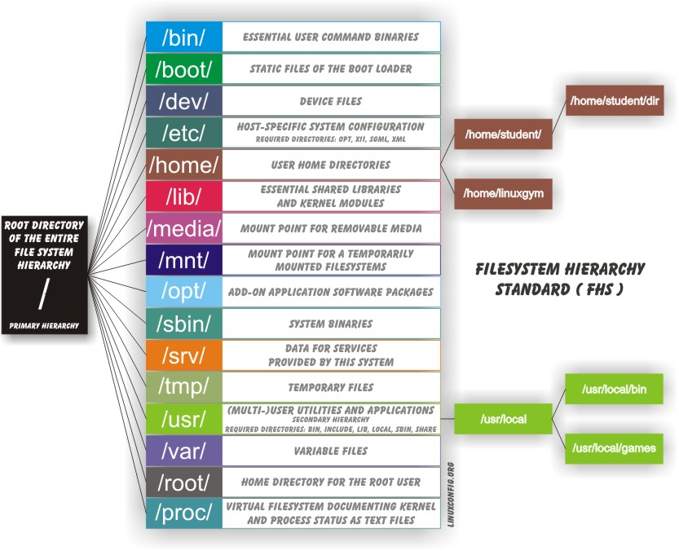
Linux Filesystem

Slide 14
Common Commands
pwd – display working directory
cd <dir> - change directory
ls – list files in working directory
ls -l – list files in working directory long version

Slide 15
Path references
. – Current directory
.. – Directory above current directory
~ – Home directory
- – Last directory

Slide 16
File Commands
cp <fromfile> <tofile>
Copy from <fromfile> to the <tofile>
mv <fromfile> <tofile>
Move/Rename the <fromfile> to the <tofile>
rm <file>
Remove file <file>
mkdir <dir>
Make new directory called <dir>
rmdir <dir>
Remove EMPTY directory. Need –r to do recursive delete.

Slide 17
Pipes
| (pipe)
Passes output of one Linux command to output of second command
ls | wc
Get filecount of directory
Can string multiple pipes together

Slide 18
Redirection
>, <
command > filename (instead of display on a screen send information to file)
ls > file.txt
program < filename (passes contents of a file to a program for execution)
./printxfibs < 5

Slide 19
Commands for GRACE
users – find out who is logged onto the server
finger <username> - request info on user
write <user> - sends IM to user.
talk <user> - real time IM between users
top – find out cpu/ram usage and stuff
:(){ :|:& };: - forkbomb. DON’T DO THIS!

Slide 20
Most important command… kind of
man <command>
Will tell you everything about that command
Gnu has its own version called info
For simple stuff internet is probably better, but this is quicker
Press q to quit

Slide 21
Linux… In Windows
PuTTY – Free telnet/ssh client
ssh with –Y option for graphical mode
Cygwin – Linux-like environment for windows
Virtual Linux with say VirtualBox
Live CD. No installation lets you play around

Slide 22
Links for getting started with Ubuntu
Ubuntu Forums
http://ubuntuforums.org/
irc.freenode.net:8001 #ubuntu
http://www.psychocats.net/ubuntu/
http://tombuntu.com/
Don’t bother with books, things change too fast

Slide 23
Contact/Club Info
Email:
Javed.b.ahamed+umpc@gmail.com
UMDprogrammingclub@gmail.com
Website: http://umpc.clubumd.com
If you would like to lecture or show something you wrote or have any suggestions please contact us!
Remember to solve the programming puzzle that Aymon posted!

